Slide 1

6th Grade Accelerated Math
Unit 8, Lesson 2 Volume of Rectangular Prisms Volume 2, pg. 11

Slide 2


Benchmark
MA.6.GR.2.3
Solve mathematical and real-world problems involving the volume of right rectangular prisms with positive rational number edge lengths using a visual model and a formula.
volume 2, pg. 11

Slide 3
Integrated Mathematical Thinking and Reasoning Standards
MA.K12.MTR.1.1 Actively participate in effortful learning both individually and collectively.
MA.K12.MTR.2.1 Demonstrate understanding by representing problems in multiple ways.
MA.K12.MTR.3.1 Complete tasks with mathematical fluency.
MA.K12.MTR.4.1 Engage in discussions that reflect on the mathematical thinking of self and others.
MA.K12.MTR.5.1 Use patterns and structure to help understand and connect mathematical concepts.
MA.K12.MTR.6.1 Assess the reasonableness of solutions.
volume 2, pg. 11

Slide 4

Learning Target
I can find the volume of a rectangular prism.
volume 2, pg. 11

Slide 5

Warm-Up
volume 2, pg. 11

Slide 6
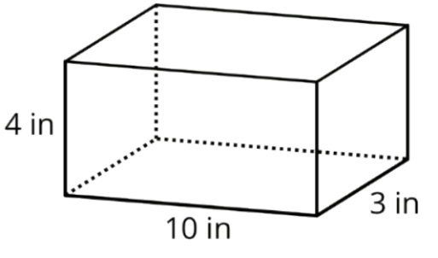
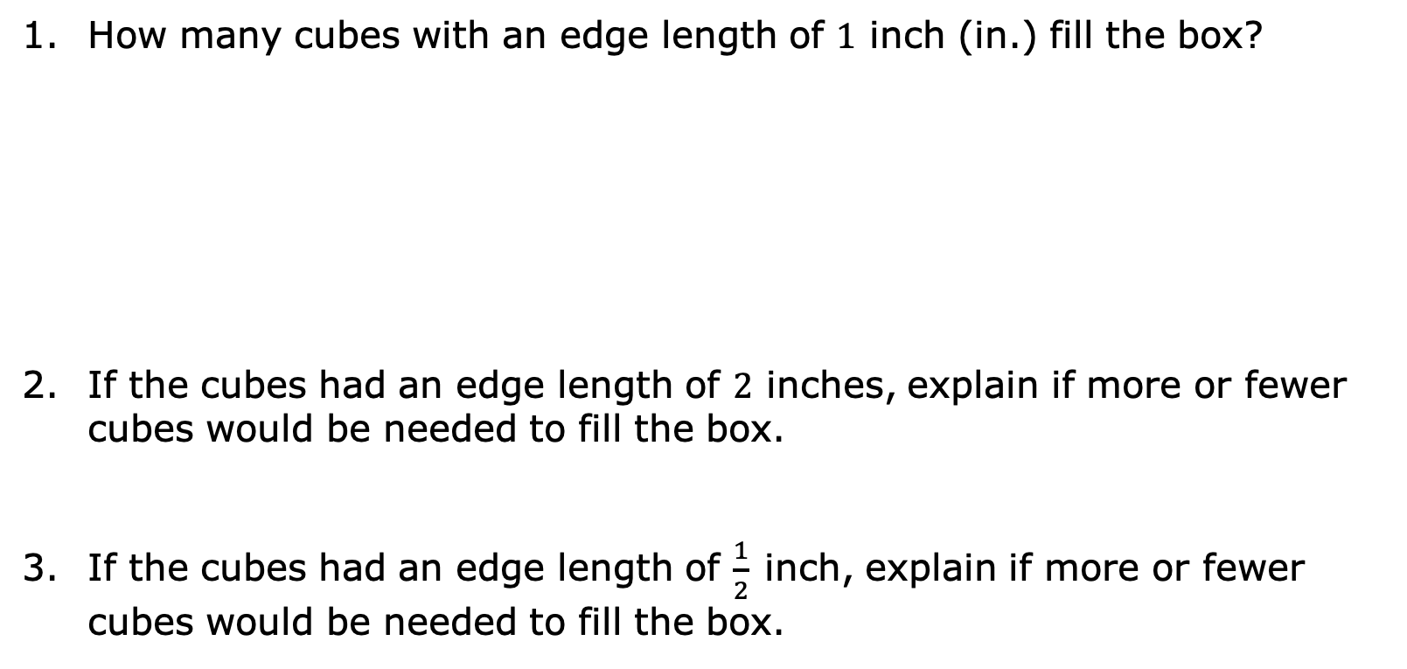
8.2.1 Warm-Up: A Box of Cubes
How many cubes with an edge length of 1 inch (in.) fill the box?
If the cubes had an edge length of 2 inches, explain if more or fewer cubes would be needed to fill the box.
If the cubes had an edge length of $\frac{1}{2}$inch, explain if more or fewer cubes would be needed to fill the box.
volume 2, pg. 11

Slide 7

Guided Instruction
volume 2, pg. 12

Slide 8
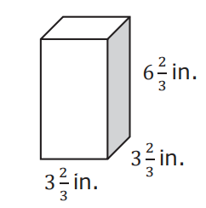
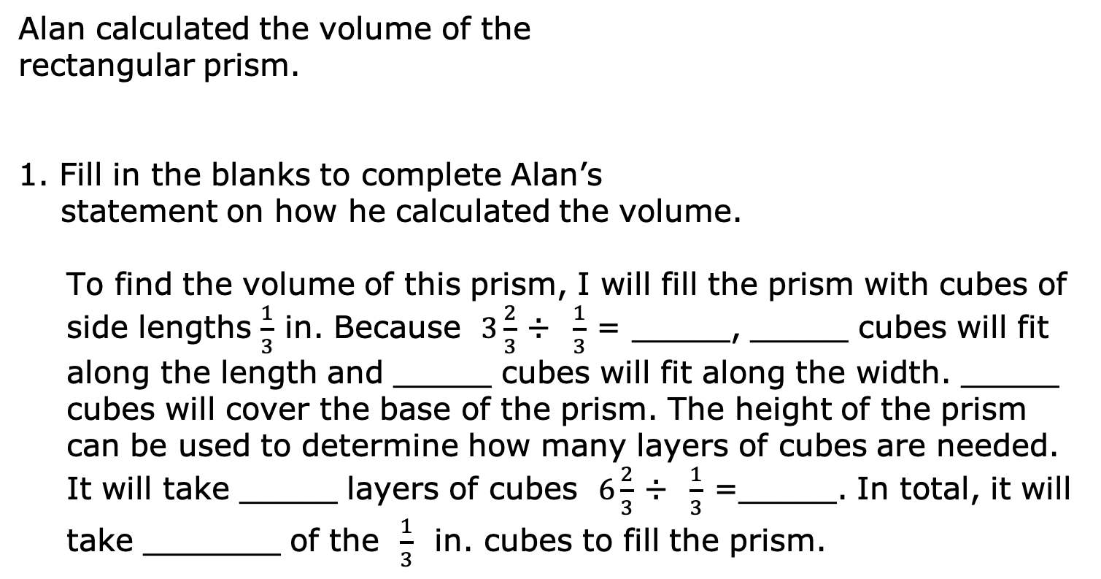
8.2.2 Guided Instruction: Two Methods for Finding the Volume of a Right Rectangular Prism
Alan calculated the volume of the
rectangular prism.
1. Fill in the blanks to complete Alan’s
statement on how he calculated the volume.
To find the volume of this prism, I will fill the prism with cubes of side lengths $\frac{1}{3}$ in. Because $3\frac{2}{3}$ ÷ $\frac{1}{3}$ = _____, _____ cubes will fit along the length and _____ cubes will fit along the width. _____ cubes will cover the base of the prism. The height of the prism can be used to determine how many layers of cubes are needed. It will take _____ layers of cubes $6\frac{2}{3}$ ÷ $\frac{1}{3}$ =_____. In total, it will take _______ of the $\frac{1}{3}$ in. cubes to fill the prism.
volume 2, pg. 12

Slide 9
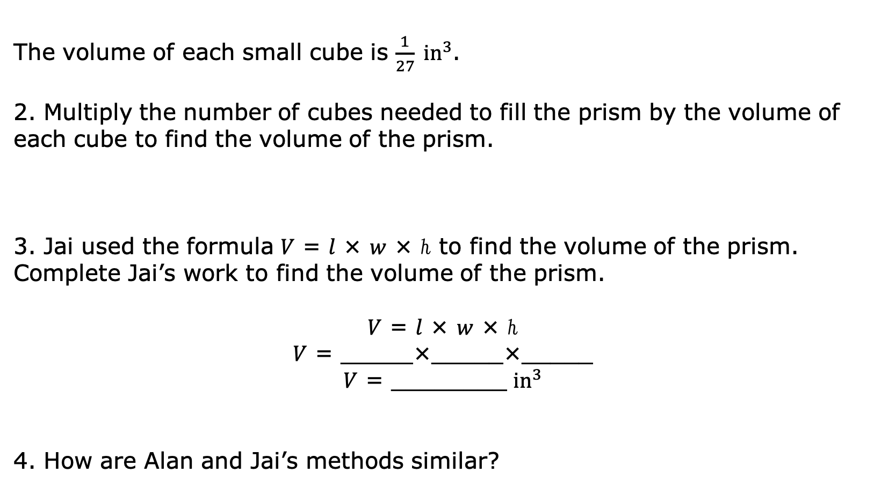
The volume of each small cube is $\frac{1}{27} {in}^{3}$.
2. Multiply the number of cubes needed to fill the prism by the volume of each cube to find the volume of the prism.
3. Jai used the formula 𝑉 = 𝑙 × 𝑤 × ℎ to find the volume of the prism. Complete Jai’s work to find the volume of the prism.
𝑉 = 𝑙 × 𝑤 × ℎ
𝑉 = _____×_____×_____
𝑉 = ________ ${in}^{3}$
4. How are Alan and Jai’s methods similar?
volume 2, pg. 12

Slide 10
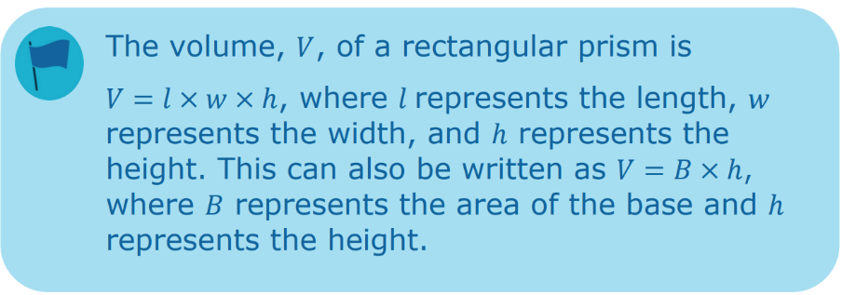
5. Discuss with your partner how the formula 𝑉 = 𝐵 ∙ ℎ is related to the formula 𝑉 = 𝑙 ∙ 𝑤 ∙ ℎ.
volume 2, pg. 12

Slide 11
6. Complete the statements based on your discussion.
The product of the length, 𝑙, and the width, 𝑤, is equal to _____________________________________ of the prism.
𝐵 = _______ × _______
Both formulas can be used to find the volume of a right rectangular prism.
volume 2, pg. 13

Slide 12

Guided Practice
volume 2, pg. 13

Slide 13

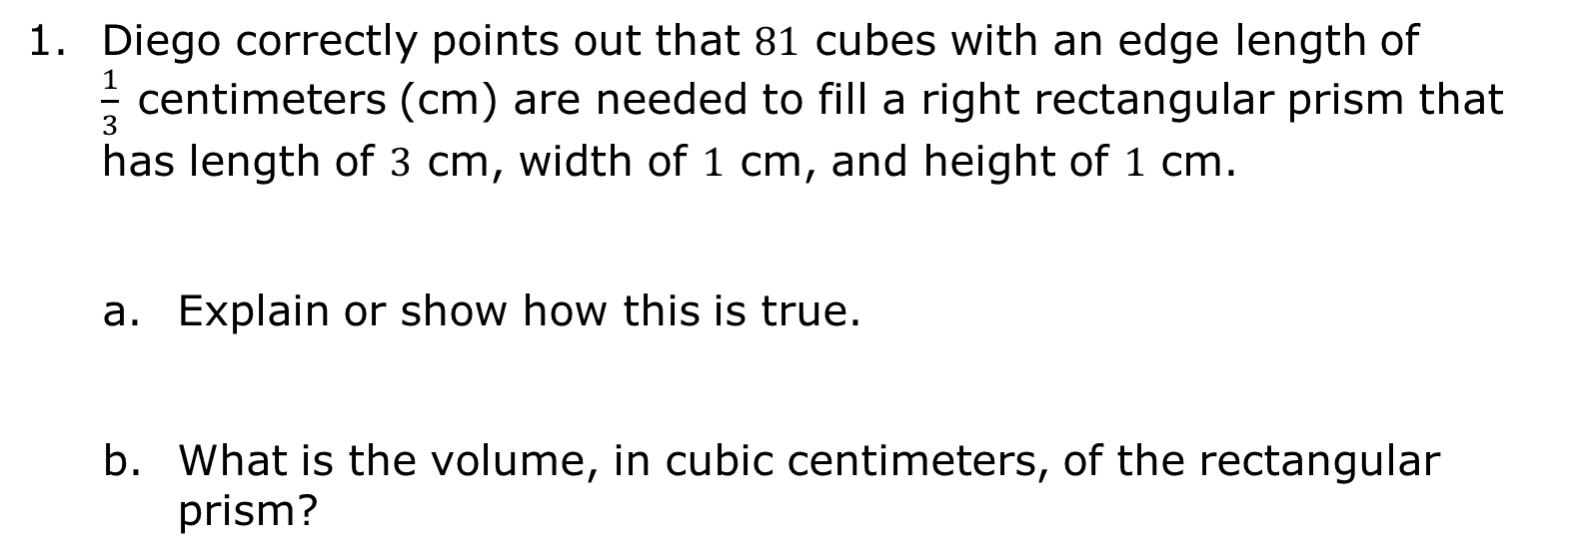
8.2.3 Guided Practice: Volume of a Right Rectangular Prism
Diego correctly points out that 81 cubes with an edge length of $\frac{1}{3}$centimeters (cm) are needed to fill a right rectangular prism that has length of 3 cm, width of 1 cm, and height of 1 cm.
Explain or show how this is true.
What is the volume, in cubic centimeters, of the rectangular prism?
volume 2, pg. 13

Slide 14
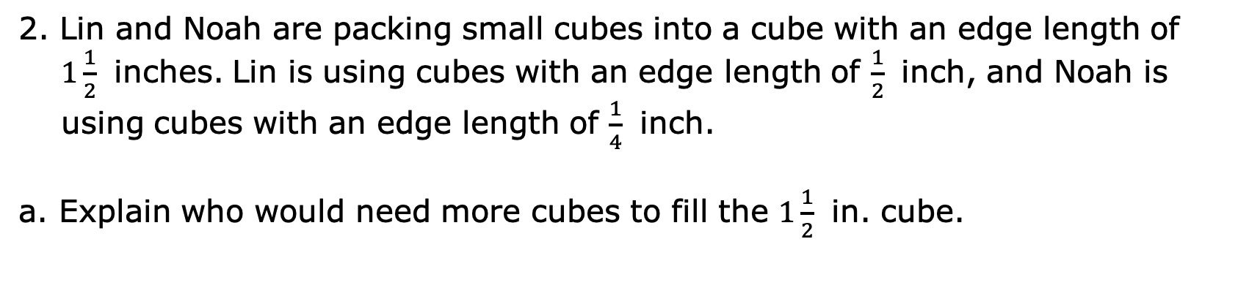
2. Lin and Noah are packing small cubes into a cube with an edge length of $1\frac{1}{2}$ inches. Lin is using cubes with an edge length of $\frac{1}{2}$ inch, and Noah is using cubes with an edge length of $\frac{1}{4}$ inch.
a. Explain who would need more cubes to fill the $1\frac{1}{2}$ in. cube.
volume 2, pg. 13

Slide 15
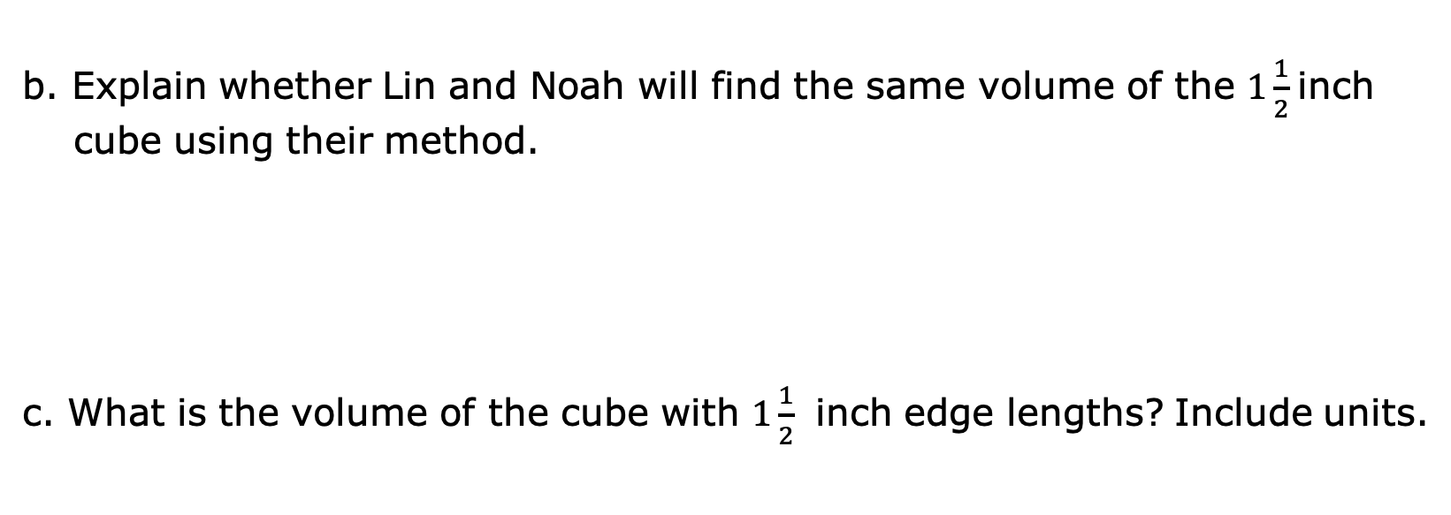
b. Explain whether Lin and Noah will find the same volume of the $1\frac{1}{2}$inch cube using their method.
c. What is the volume of the cube with $1\frac{1}{2}$ inch edge lengths? Include units.
volume 2, pg. 14

Slide 16
3. A toy company is packaging its toys to be shipped. Some small toys are placed inside a cube-shaped box with side lengths of 0.5 inches (in.). These smaller boxes are then packed into a shipping box with dimensions of 12 in. × 35 in. × 2.5 in.
How many small toys can be packed into the larger box for shipping?
Use the number of toys that can be shipped in the box to determine the volume of the box. Include units.
volume 2, pg. 14

Slide 17

Your Turn
volume 2, pg. 14

Slide 18
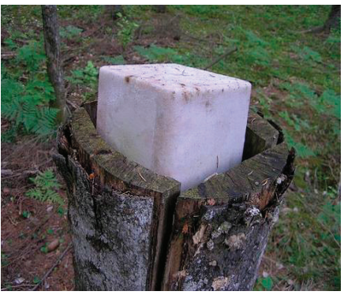
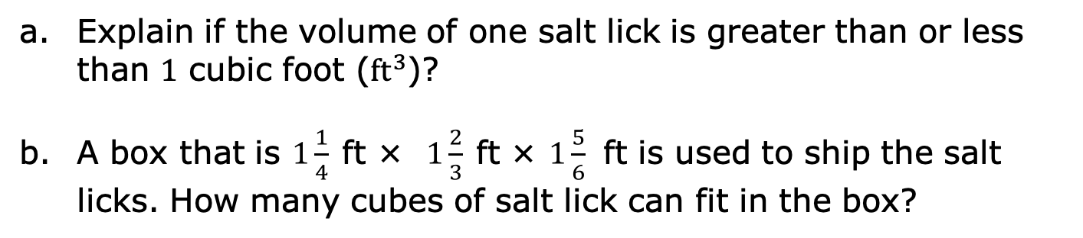
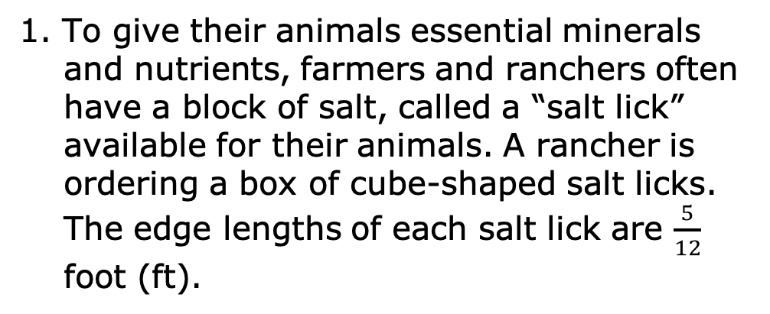
8.2.4 Your Turn!
1. To give their animals essential minerals and nutrients, farmers and ranchers often have a block of salt, called a “salt lick” available for their animals. A rancher is ordering a box of cube-shaped salt licks. The edge lengths of each salt lick are $\frac{5}{12}$ foot (ft).
Explain if the volume of one salt lick is greater than or less than 1 cubic foot (${ft}^{3}$)?
A box that is $1\frac{1}{4}$ft × $1\frac{2}{3}$ft × $1\frac{5}{6}$ ft is used to ship the salt licks. How many cubes of salt lick can fit in the box?
volume 2, pg. 14

Slide 19
2. A pool in the shape of a rectangular prism is being filled with water. The dimensions of the pool are 24 feet (ft) by 15 ft. If the height of the water in the pool is 1.3 ft, what is the volume of the water in cubic feet?
volume 2, pg. 15

Slide 20

Wrap-Up
volume 2, pg. 15

Slide 21
8.2.5 Wrap-Up: Ticket Out the Door
Joy keeps her modeling clay in a plastic box that has a length of 21 centimeters (cm), a width of 21 cm, and a height of 63 cm.
What is the volume of the plastic box? Include units.
If each piece of cube-shaped clay has a side length of 4.2 cm, how many pieces of clay can be stored in the box?
volume 2, pg. 15

